Slide 1
Journey Map
Aum Rajadnye
Associate Data Engineer

Slide 2

Journey Map
Custom Training
Aum Rajadnye
Associate Data Engineer

Slide 3
Azure Storage Account (04/09/23)
Azure Storage Account - a unique namespace that contains all of your Azure Storage data objects: blobs, files, queues, and tables
Types of storage accounts - Standard general-purpose v2, Premium block blobs, Premium file share, Premium page blobs
Storage redundancy in Azure – Locally redundant Storage, Zone Redundant Storage, Geo Redundant Storage, Geo Zone Redundant Storage

Slide 4
Azure Storage Account (05/09/23)
Azure Blob Storage - To store large amounts of unstructured object data
Create containers on Azure Storage to organize blobs
Azure File Share to mount file shares
Accessing the mounted file share through a Windows VM
Azure Key Vault - a cloud service for securely storing and accessing secrets, such as passwords or API keys

Slide 5
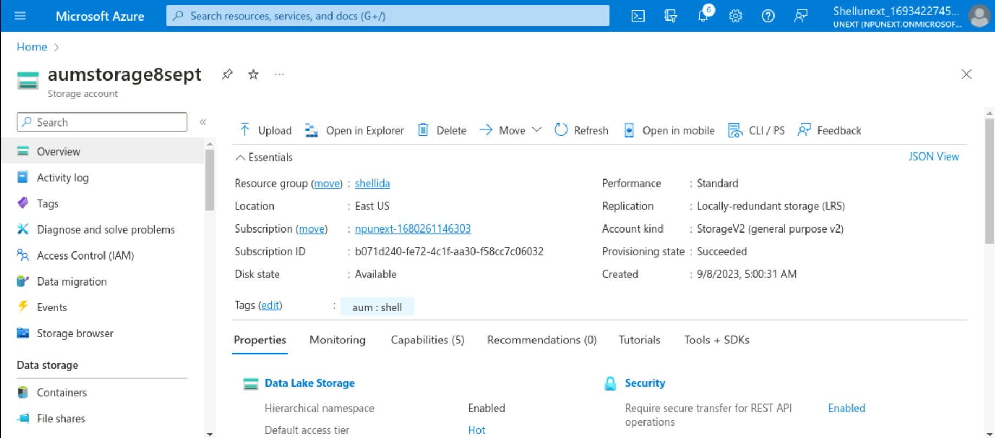

Slide 6
Azure Data Factory (06/09/23)
What is Azure Data Factory?
a series of interconnected systems that provide a complete end-to-end platform for data engineers
It provides code free ETL services
Pipelines and data flows in Azure Data Factory -
Pipeline is a logical grouping of activities that together perform a task
Data flows are visually designed data transformations in Azure Data Factory

Slide 7
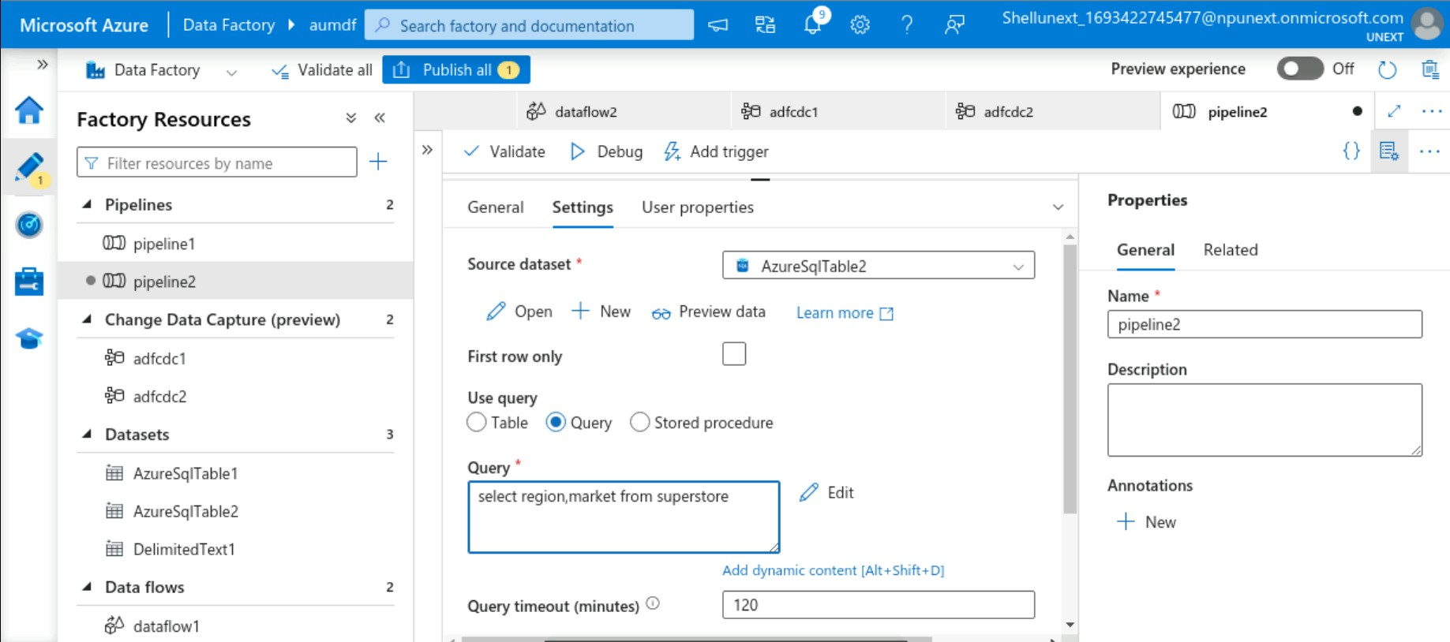
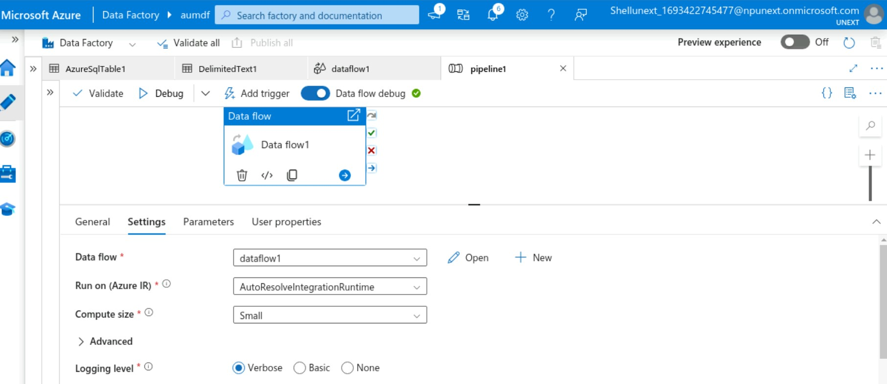

Slide 8
Azure Data Factory (07/09/23)
ForEach - ForEach Activity defines a repeating control flow in an Azure Data Factory pipeline
If Condition - It executes a set of activities when the condition evaluates to true and another set of activities when the condition evaluates to false
Join Condition - Join transformation to combine data from two sources or streams in a mapping data flow

Slide 9
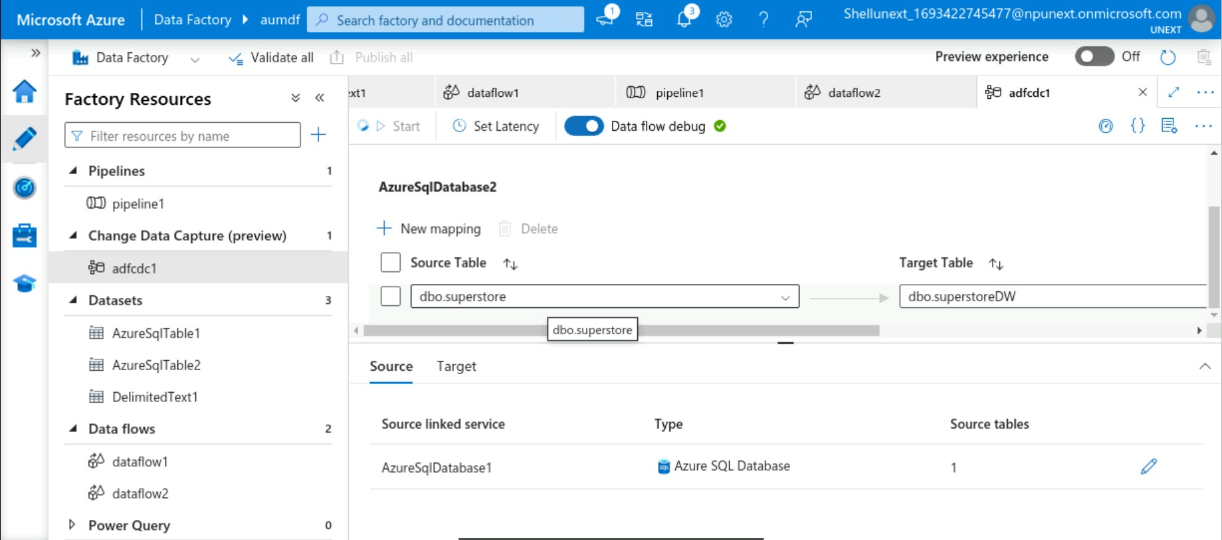
Aggregation (08/09/23)
Using Azure SQL Database with Azure Data Factory

Slide 10
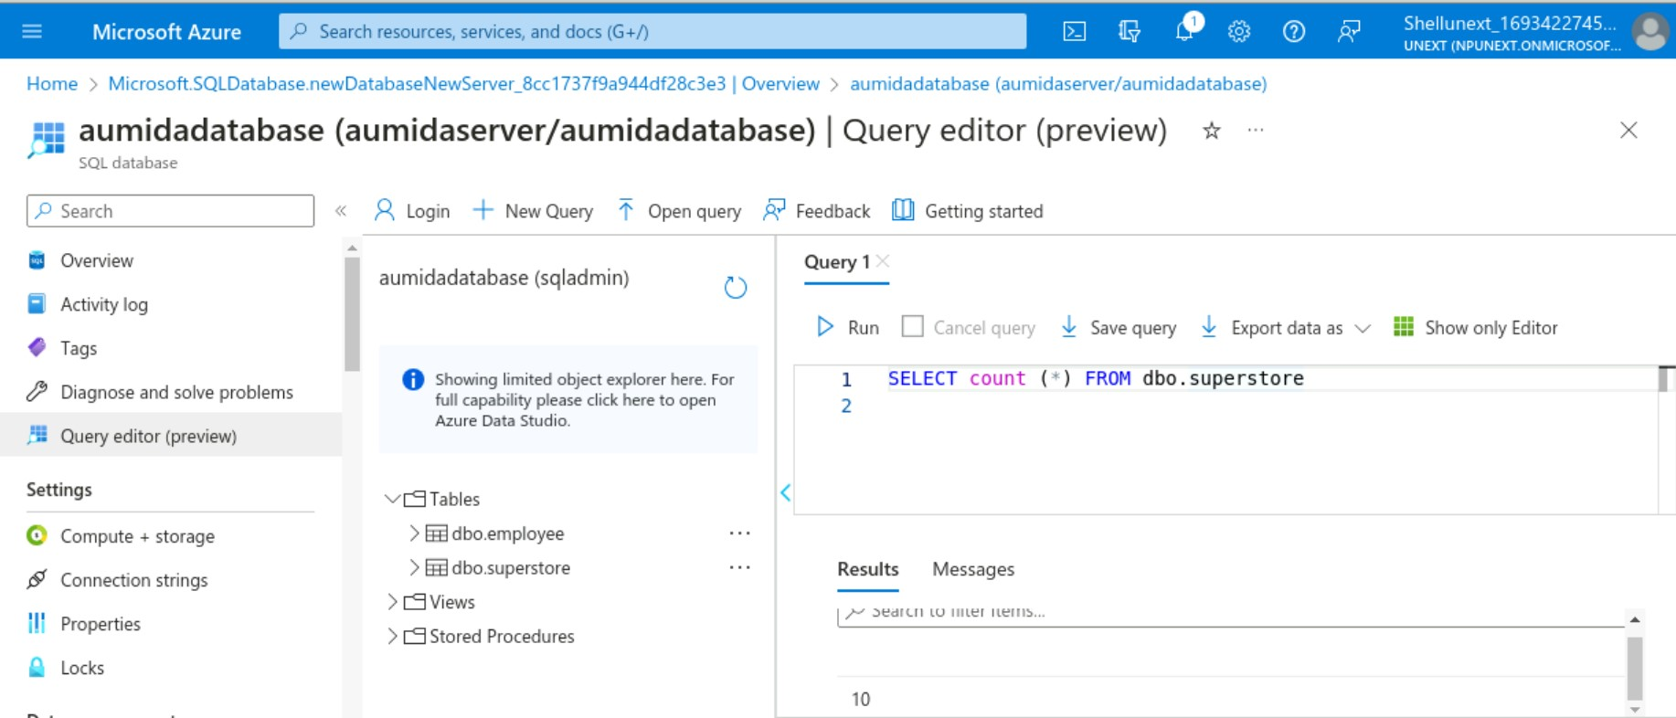
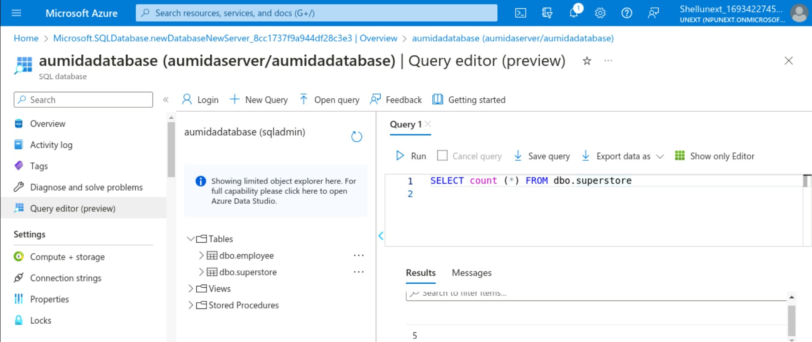

Slide 11
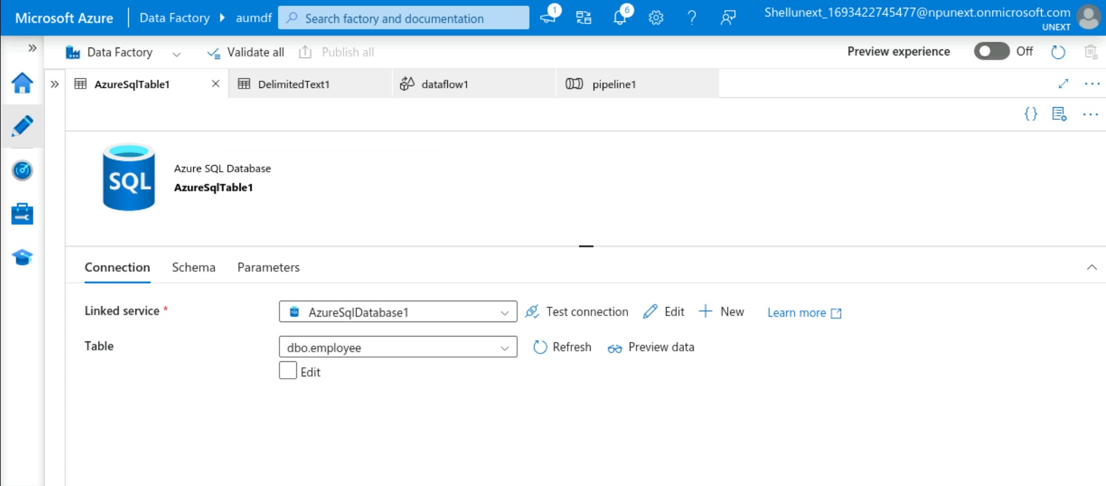
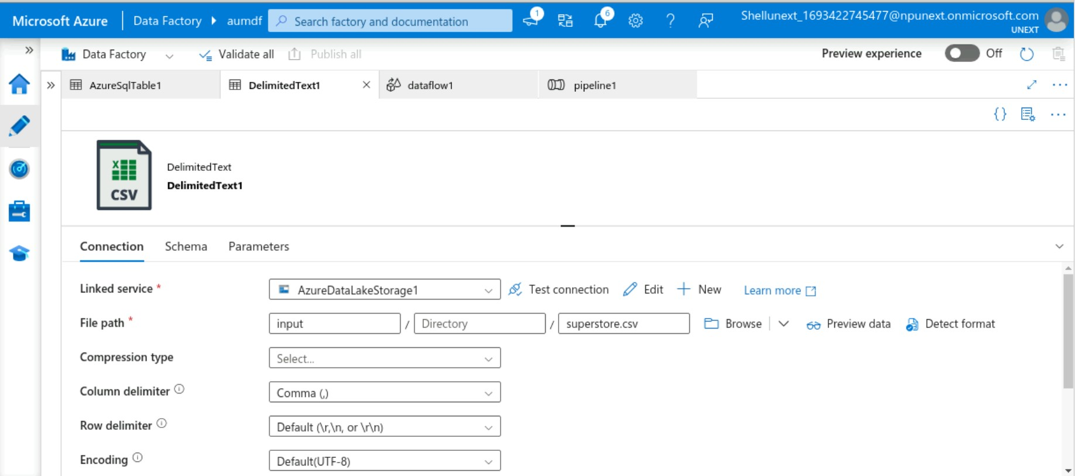

Slide 12
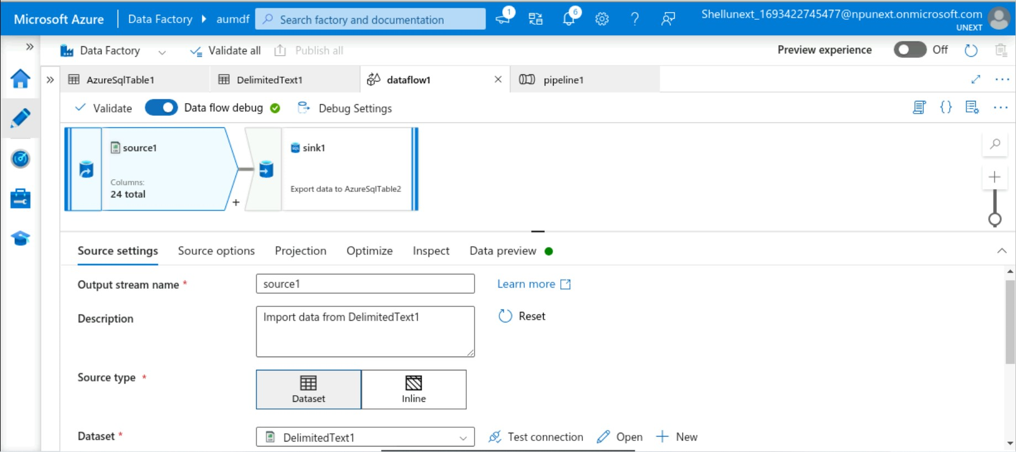
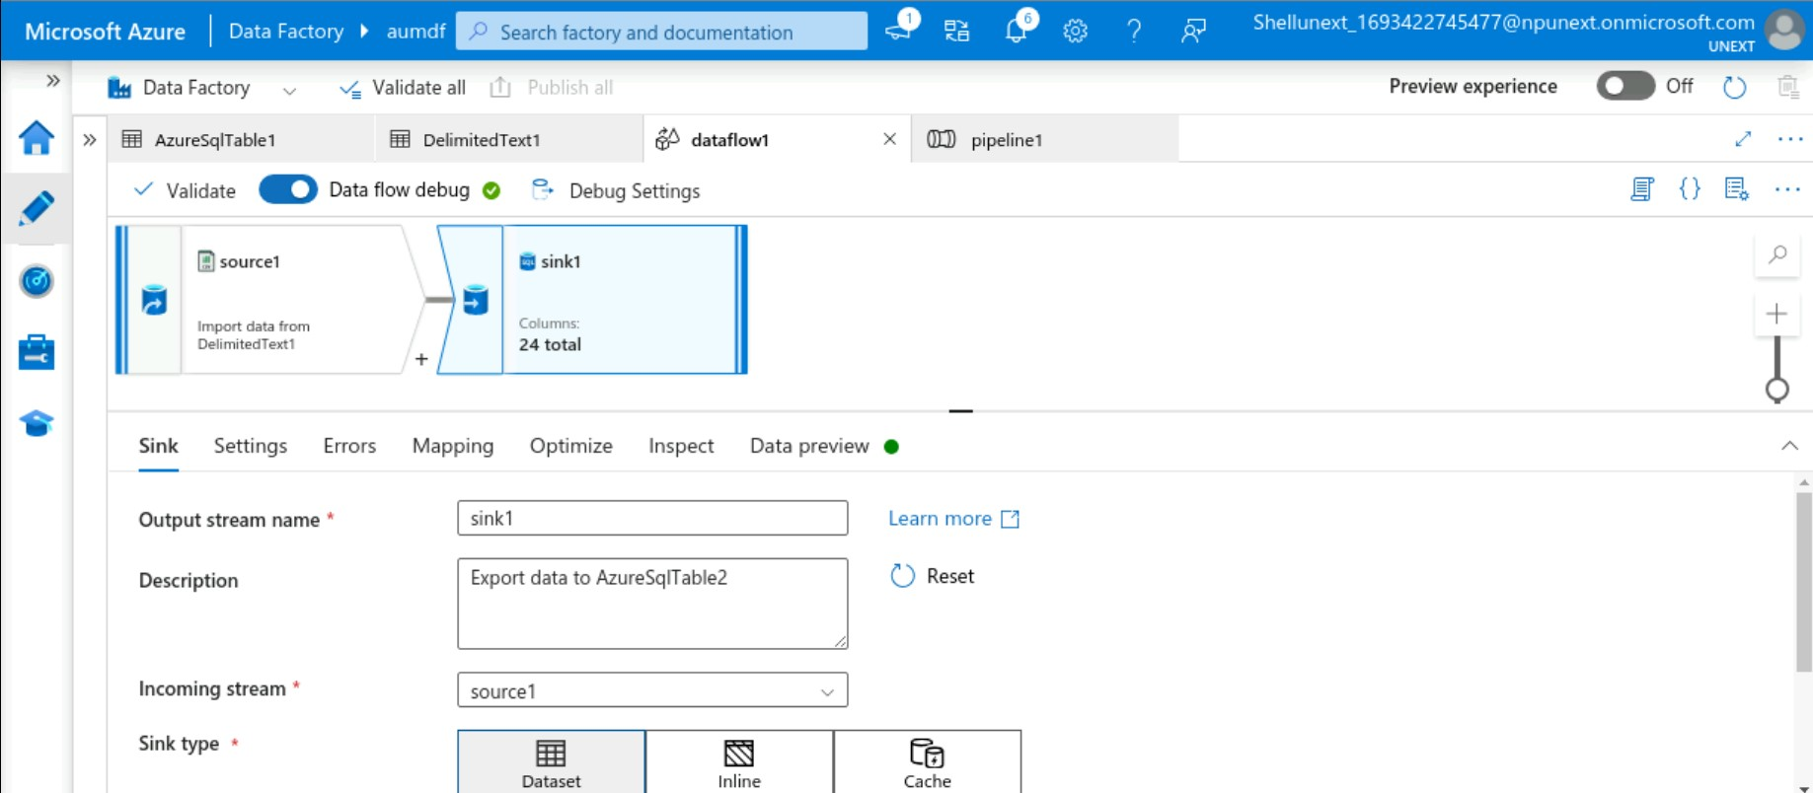

Slide 13
